Slide 1

A Big Data Spreadsheet
Mihai Budiu – VMware Research Group (VRG)
Universitatea Politehnica Bucuresti – July 31, 2018
Joint work with
Parikshit Gopalan, Lalith Suresh, Udi Wieder, Marcos Aguilera – VMWare Research
Han Kruiger – University of Groningen, intern at VRG

Slide 2

About Myself
B.S., M.S. from Politehnica Bucuresti
Ph.D. from Carnegie Mellon
Researcher at Microsoft Research, Silicon Valley
Distributed systems, security, compilers, cloud platforms, machine learning, visualization
Software engineer at Barefoot Networks
Programmable networks (P4)
Researcher at VMware Research Group
Big data, programmable networks

Slide 3

& VRG
VMware:
~20K employees
Founded 1998 by Stanford Faculty; hq in Palo Alto, CA
Virtualization, networking, storage, security, cloud management
7.92 billion USD annual revenue; valuation of 60 billion
VRG (VMware Research Group):
Founded 2014
About 30 full-time researchers
Labs in Palo Alto and Herzliya, Israel
Distributed systems, networking, OS, formal methods, computer architecture, FPGAs, compilers, algorithms

Slide 4


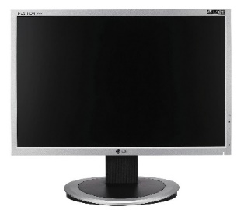
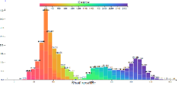
Browsing big data
Interactive visualization of billion row datasets
Slice and dice data with the click of a mouse
No coding required
http://github.com/vmware/hillview
Apache 2 license

Slide 5




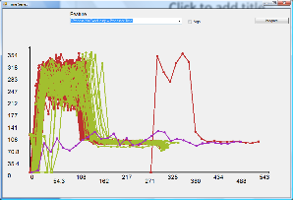
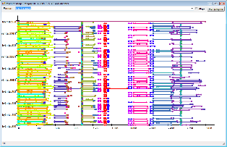
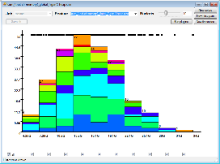
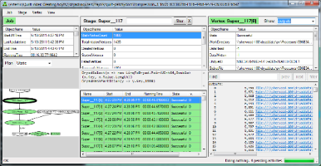
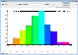
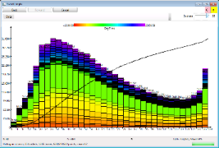
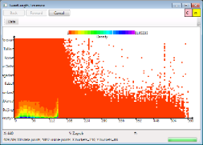
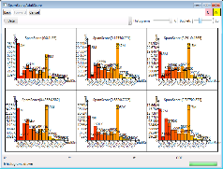
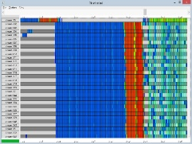
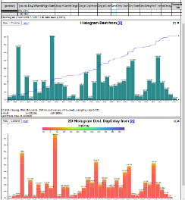
History
2006 | Dryad (Eurosys 2007) deployed by Microsoft Live Search
2008 | DryadLINQ (OSDI 2008); Artemis DryadLINQ job profiler (WASL 2008)
2011 | Daphne DryadLINQ job debugger (HIPS 2011); Fay distributed safe tracing (SOSP 2011)
2014 | Sketch spreadsheet (EGPGV 16) [MSR SVC closed]
2016

Slide 6


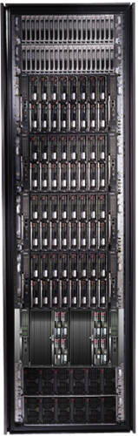
Bandwidth hierarchy
These channels are lossy!
Compute approximate data views with an error < channel error.

Slide 7
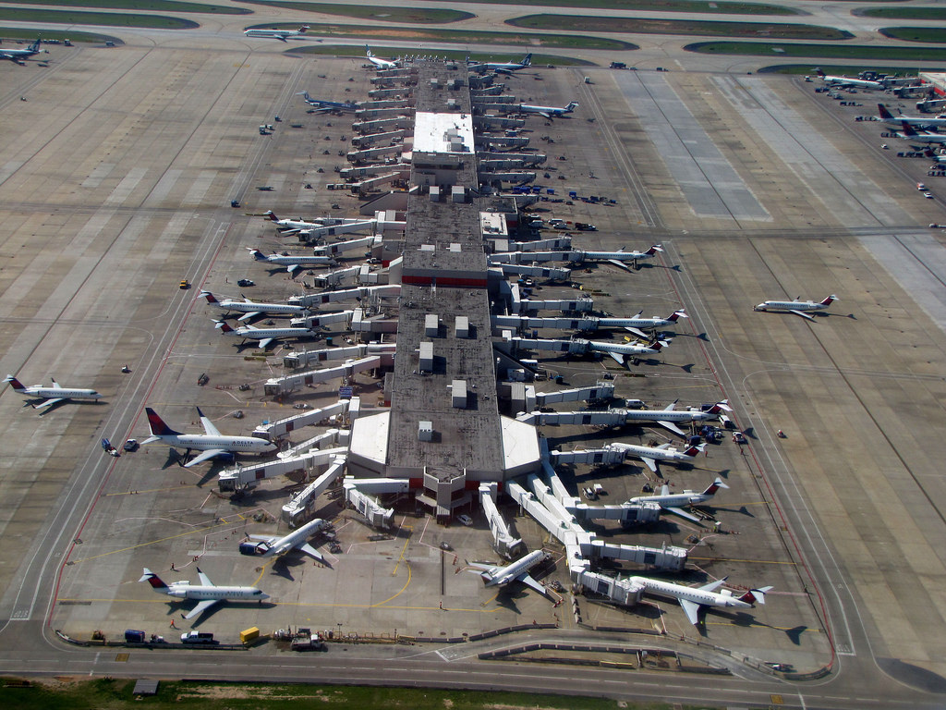
Demo
Real-time video
Browsing a 129 million
.5M flights/month
All US flights in last 21 years
Public data from FAA website
Running on 20 small VMs (25GB of RAM, 4 CPU cores each)
https://1drv.ms/v/s!AlywK8G1COQ_jeRQatBqla3tvgk4FQ

Slide 8


Slide 9

Outline
Motivation
Fundamental building blocks
System architecture
Visualization as sketches
Evaluation
Conclusion

Slide 10
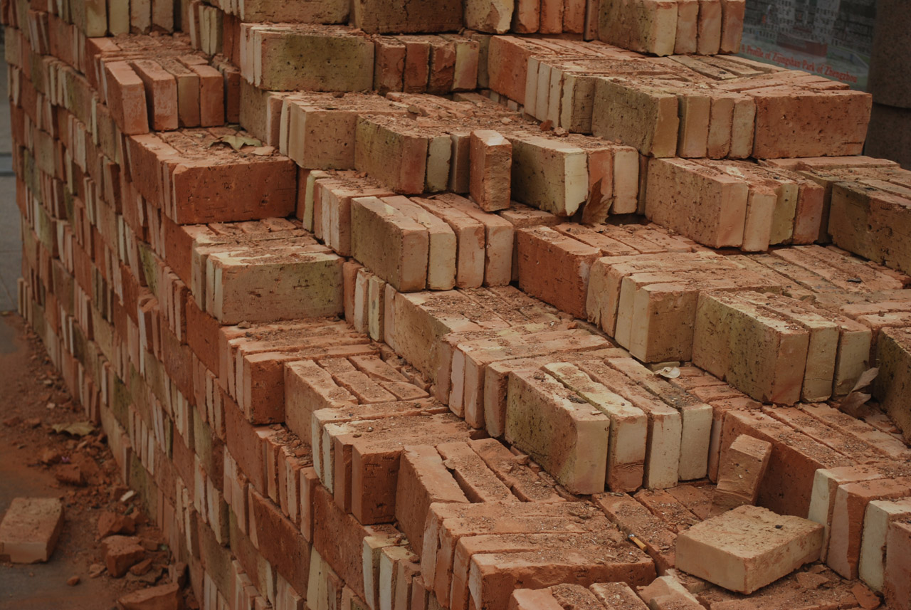
Hillview Building Blocks

Slide 11

Monoids
A set M with
An operation + : M x M -> M
A distinguished zero element: a + 0 = 0 + a = a
Commutative if a + b = b + a
interface IMonoid<R> { R zero(); R add(R left, R right);
}

Slide 12
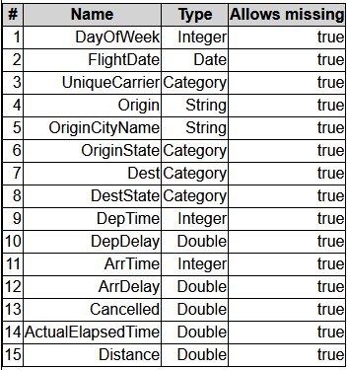
Abstract Computational Model
Output O
Post
processing
“sketch”
R must be “small”
(independent on N,
dependent on screen size)
R
add
R
R
add
add
R
R
R
R
Streaming/ sampling algorithm
sketch
sketch
sketch
sketch
Input data, sharded
Multi-set of N tuples

Slide 13
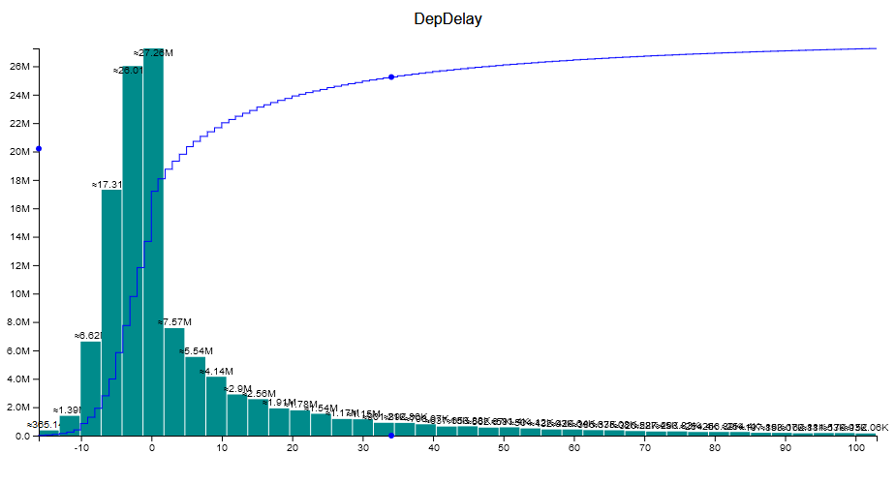
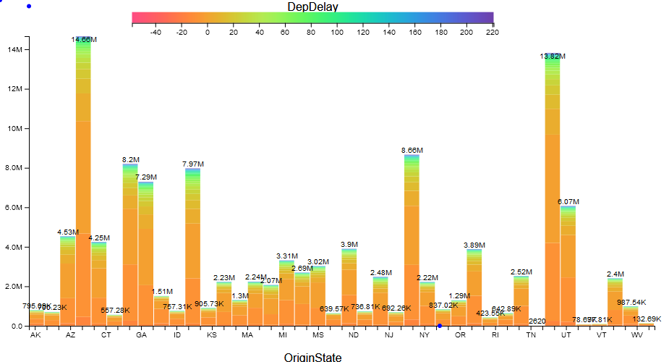
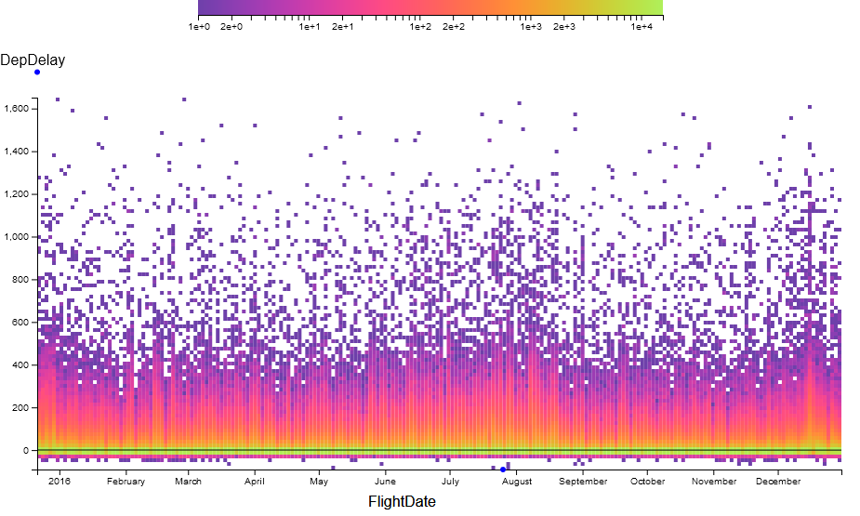
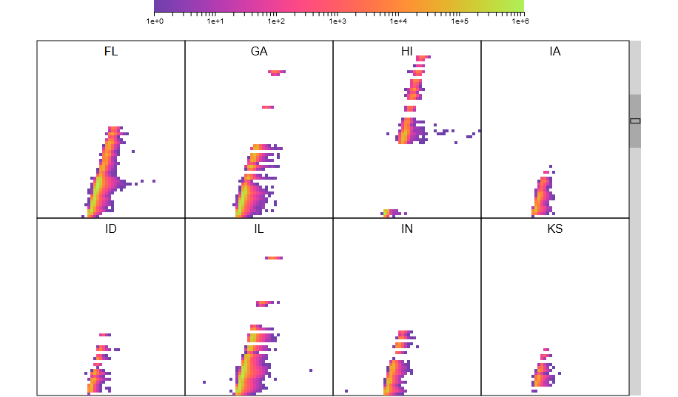
All Renderings in Hillview are sketches!

Slide 14
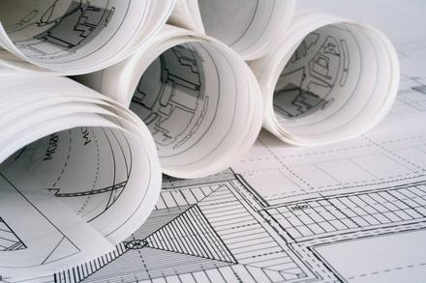
System architecture

Slide 15
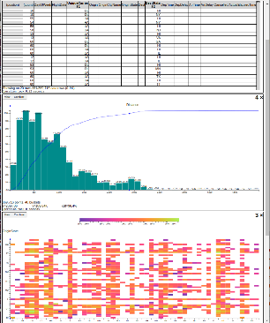


Hillview System architecture
Leaf
node
In-memory
table
parallel
read
Aggregation
node
Leaf
node
In-memory
table
Web front-end
Root
node
In-memory
table
Storage
Leaf
node
In-memory
table
request
In-memory
table
Storage
Remote tables refs.
Leaf
node
In-memory
table
streaming
response
Aggregation
node
In-memory
table
Storage
Redo log
In-memory
table
Client
web browser
Storage
Aggregation network
Cloud service
workers

Slide 16
Immutable Partitioned Objects
browser
handle
root node
Address spaces
Network
IDataSet<T>
T
T
T
T
T
T
T
T
T
T
T
Workers

Slide 17

DataSet Core API
interface ISketch<T,R> extends IMonoid<R> { R sketch(T data); }
interface PR<T> { // Partial result T data; double done; }
interface IDataSet<T> { Observable<PR<R>> sketch(ISketch<T,R> sk); … map(…); … zip(…); }

Slide 18
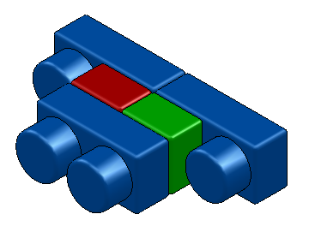
Dataset objects
Implement IDataSet<T>
Identical interfaces on top and bottom
Can be stacked arbitrarily
Modular construction of distributed systems
IDataSet
interface

Slide 19
LocalDataset<T>
Contains a reference to an object of type T in the same address space
Directly executes operations (map, sketch, zip) on object
Local
T

Slide 20
ParallelDataset<T>
Has a number of children of type IDataSet<T>
Dispatches operations to all children
sketch adds the results of children
Parallel

Slide 21
RemoteDataset<T>
Has a reference to an IDataSet<T> in another address space
The only component that deals with the network
Built on top of GRPC
Client
Remote
ref
GRPC
Server

Slide 22
A distributed dataset
Root node
Parallel
Remote
Remote
Network
worker 0
ref
worker 1
ref
ref
worker n
Parallel
Parallel
Remote
Parallel
Parallel
Local
Local
Local
Local
Local
Local
T
T
Rack 0
T
T
T
Rack r
T

Slide 23
sketch(s)
interface ISketch<T,R> extends IMonoid<R> { R sketch(T data); }
R
Remote
s.add
R
Parallel
R
R
Local
Local
s.sketch
T
T

Slide 24
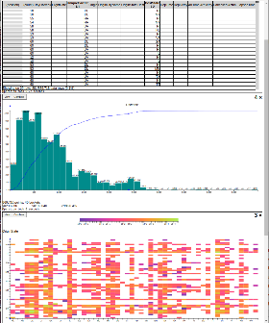
Memory management
Web front-end
Root
node
Leaf
node
In-memory
table
Memoization
cache
Remote tables refs.
In-memory
table
Storage
Redo log
Soft state (cache)
Log = lineage of all datasets
Log = JSON messages received from client
Replaying the log reconstructs all soft-state
Log can be replayed as needed

Slide 25

Visualization as sketches

Slide 26
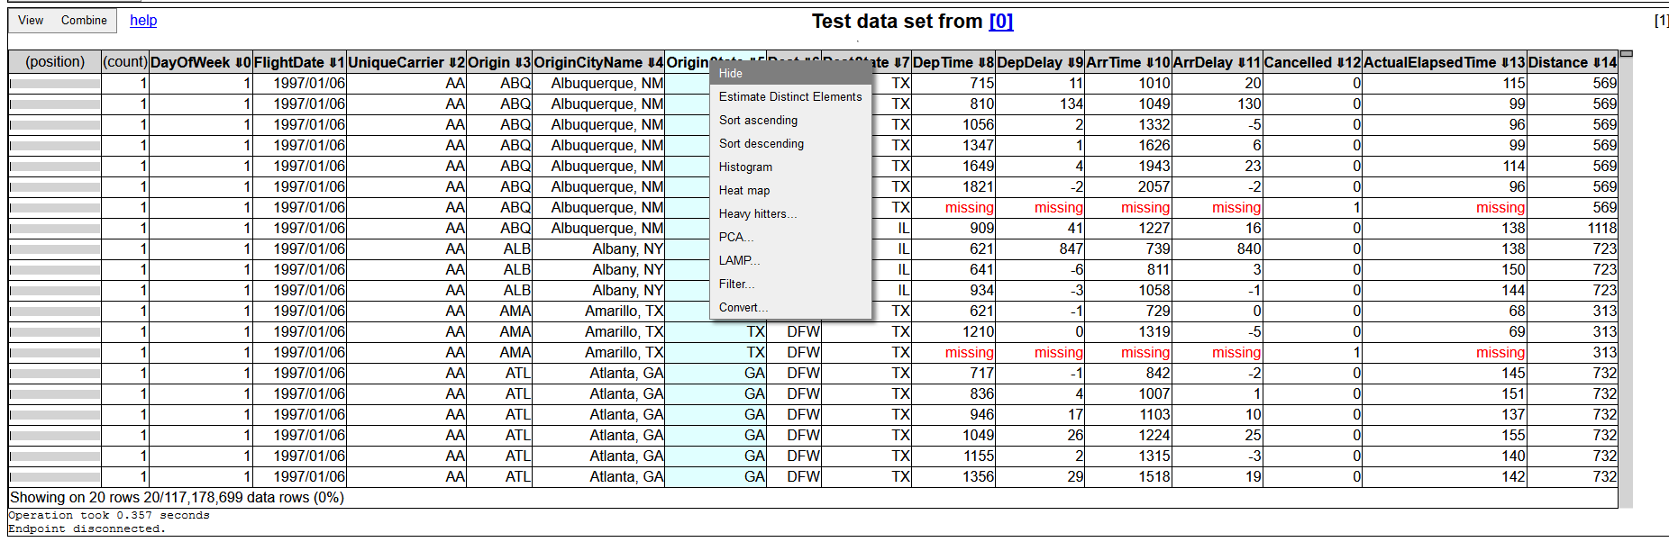
Table views
Always sorted
NextK(startTuple, sortOrder, K)
Monoid operation is “merge sort”

Slide 27
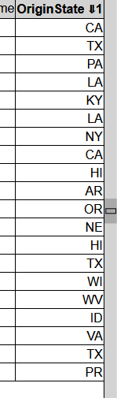
Scrolling
Compute startTuple based on scroll-bar position
Approximate quantile
Samples O(H²) rows; H = screen height in pixels

Slide 28
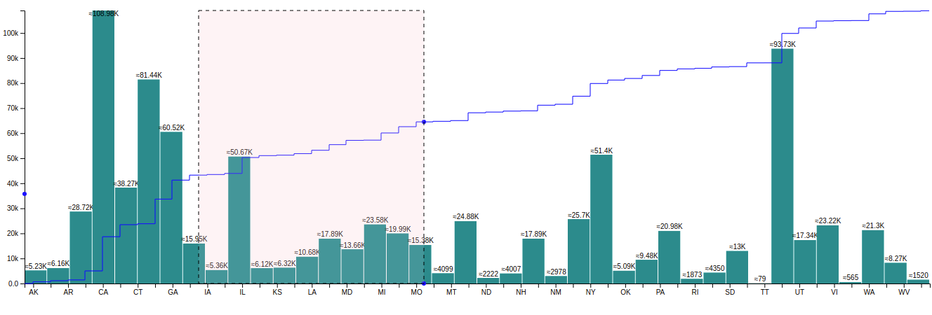
1D Histograms
CDF
Histograms are monoids (vector addition)
CDFs are histograms (at the pixel level)

Slide 29
Histograms based on sampling
Exact histogram
Approximate histogram
μ < 1/2
Actual
Legal rendering
Actual
Legal rendering
Legal rendering
pixel row
Theorem: O((HB / μ)² log(1/δ)) samples are needed to compute an approximate histogram with probability 1 – δ.
H = screen size in pixels
B = number of buckets (< screen width in pixels)
No N in this formula!

Slide 30
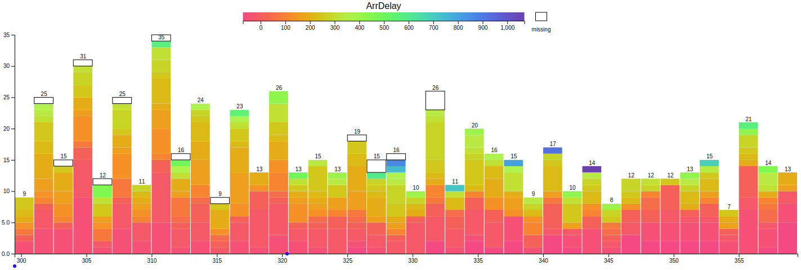
2D Histograms

Slide 31
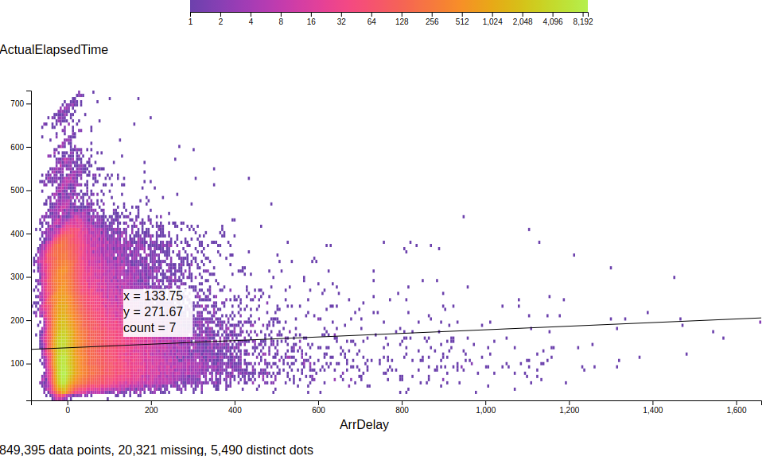
Heatmaps
Linear regression

Slide 32
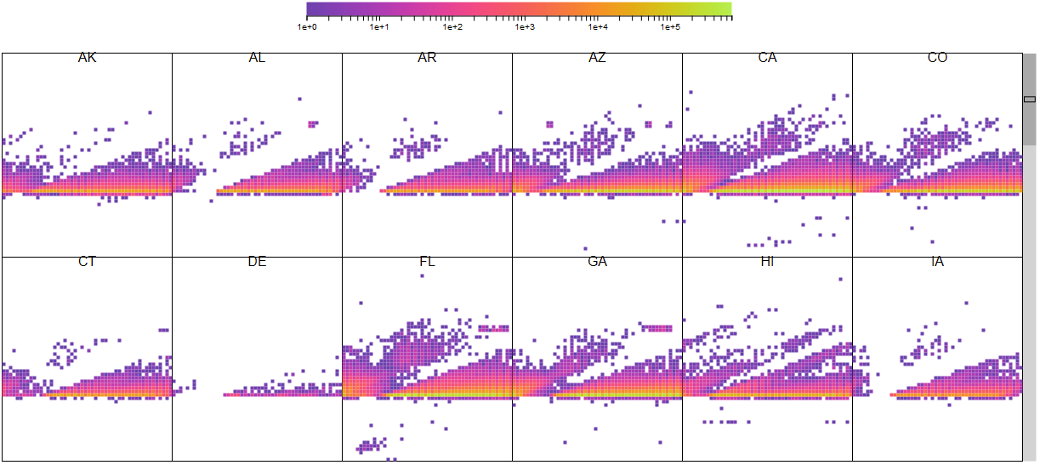
Trellis plots

Slide 33

Evaluation

Slide 34
Evaluation system
TOR switch
LAN
Web front-end
Root aggregator
Worker
8 servers
Intel Xeon Gold 5120 2.2GHz (2 sockets x 14 cores x 2 hyperthreads)
128GB RAM/machine
Ubuntu Server
10Gbps Ethernet in rack
2 SSDs/machine
client
…
Worker
Worker
rack

Slide 35
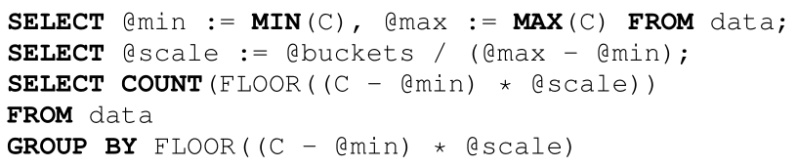
Comparison against database
Commercial database [can’t tell which one]
In-memory table
100M rows
DB takes 5,830ms (Hillview is 527ms)

Slide 36
Cluster-level weak scaling
Histogram, 100M elements/shard, 64 shards/machine
Computation gets faster as dataset size grows!

Slide 37
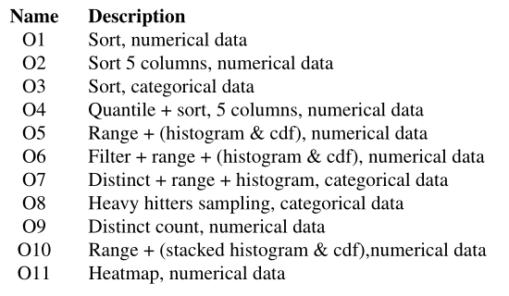
Comparison against Spark
5x the flights dataset (71B cells)
Spark times do not include UI rendering

Slide 38
Scaling data
5x | 71B cells
10x | 143B cells
100x | 1.43T cells
ORC data files, includes I/O and rendering

Slide 39

Conclusion

Slide 40

Lessons learned
Always think asymptotics (data size/screen size)
Define “correct approximation” precisely
Small renderings make browser fast
Two kinds of visualizations: trends and outliers
Don’t forget about missing data!
Sampling is not free; full scans may be cheaper
Redo log => simple memory management

Slide 41
Related work [a small sample]
Big data visualization
Databases, commercial products Polaris/Tableau, IBM BigSheets, inMens, Nanocubes, Hashedcubes, DICE, Erma, Pangloss, Profiler, Foresight, iSAX, M4, Vizdom, PowerBI
Big data analytics for visualization
MPI Reduce, Neptune, Splunk, MapReduce, Dremel/BigQuery, FB Scuba, Drill, Spark, Druid, Naiad, Algebird, Scope, ScalarR
Sampling-based analytics
BlinkDB, VisReduce, Sample+Seek, G-OLA
Incremental visualization
Online aggregation, progressive analytics, ProgressiVis, Tempe, Stat, SwiftTuna, MapReduce online, EARL, Now!, PIVE, DimXplorer

Slide 42
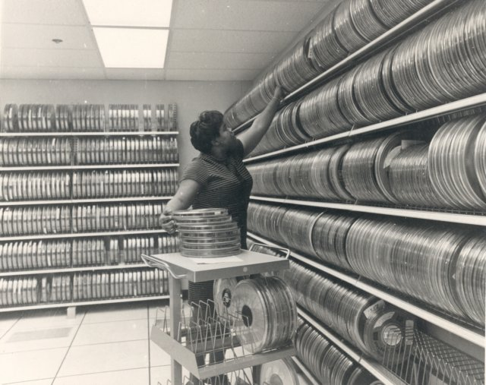
Backup slides

Slide 43

Linear transformations (homomorphisms)
Linear functions between monoids: f: M → N, f(a + b) = f(a) + f(b)
“Map” and “reduce” are linear functions
Linear transformations are the essence of data parallelism
Many streaming algorithms are linear transformations

Slide 44
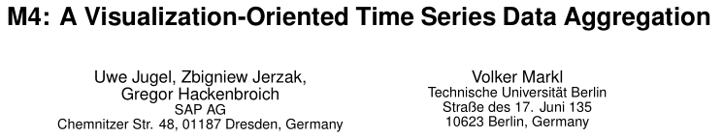
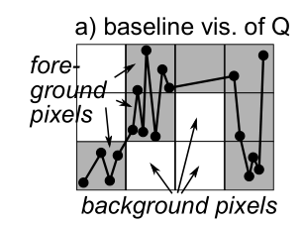
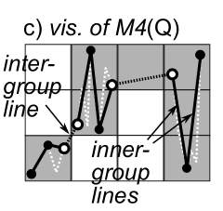
Pixel-level quantization

Slide 45

Reactive streams (RxJava)
interface Observable<T> { Subscription subscribe(Observer<T> observer); } interface Observer<T> { void onNext(T value); void onError(Throwable error); void onCompleted(); }
March 2012

Slide 46
Histogram execution timeline
Progress report
Render
User click
Data range
Initiate
histogram
Completed
Client
Web server
Data range
Histogram
+ CDF
Worker 1
Time
Compute
Worker n
Full scan
Sampled scan

Slide 47

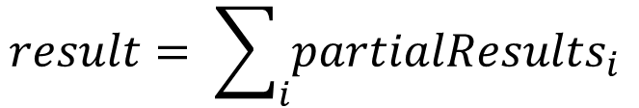
Observable roles (1)
Streaming data
Observable<R> partialResults;
$$result= \sum_{i}{{partialResults}_{i}}$$

Slide 48
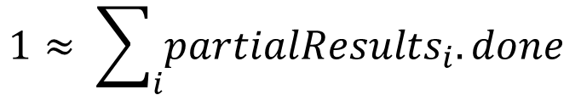
Observable roles (2)
Distributed progress reporting
class PR<T> { // A partial result double done; T data; }
Observable<PR<R>> partialResults;
$$1≈ \sum_{i}{{partialResults}_{i}.done}$$

Slide 49

Observable roles (3)
Distributed cancellation
Sketch API (C#)
async R map(Func<T, R> map, CancellationToken t, Progress<double> rep)
CancellationToken ct = cancellationTokenSource.token; Progress<double> reporter;
R result = data.map(f, ct, reporter); …
cancellationTokenSource.cancel();
Hillview API
Observable<PR<R>> map(Function<T, R> map);
Observable<PR<R>> o = data.map(f);
Subscription s = o.subscribe(observer);
…
s.unsubscribe();

Slide 50

Observable roles (4)
Concurrency management
Observable<T> data;
Observable<T> output = data.subscribeOn(scheduler);

Slide 51
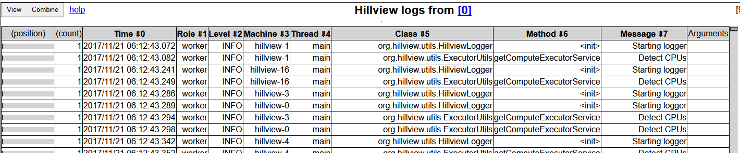
A log browser in Hillview
Spreadsheet
DataSet<Table>
Log parser
Distributed logs

Slide 52
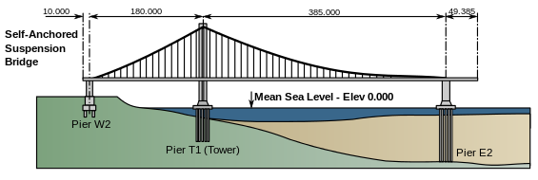
Hillview Design principles
Take display and perception limits into account
Wherever possible compute on sampled data
Compute views lazily (when users need them)
Shard data to exploit parallelism and increase responsiveness
Push computation to data
Only use sketching algorithms
Avoid hard state
Functional programming; immutable objects
Incremental view updates

Slide 53
map(f)
Remote
Remote
Parallel
Parallel
Local
Local
Local
Local
T
T
S
S
f
f

Slide 54
zip
Remote
Remote
Remote
Parallel
Parallel
Parallel
Local
Local
Local
Local
Local
Local
T
T
S
S
T,S
T,S

Slide 55
Spreadsheet architecture
UI
Front-end
DataSet<Table>
Distributed objects
Table operations
Spreadsheet logic
SQL DB
CSV Files
Column store
…
Storage layer

Slide 56
Table data storage
Table₁
Table₂
Schema₁
Columns
Columns
Schema₂
Membership
set
Membership
set
Column
data

Slide 57

MembershipSet operations
Iterate
Sample
GetIteratorOverSample
Ideally cost should be O(|output|)
Union/intersection/etc.
Multiple implementations, depending on sparsity

Slide 58

Scripting
We expose JavaScript to users
Create new columns
Write data filters
Oracle Java Nashorn JS engine

Slide 59
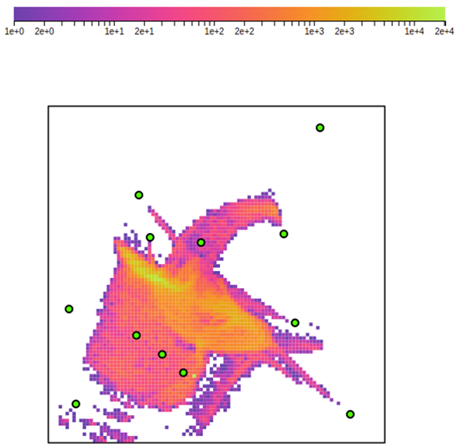
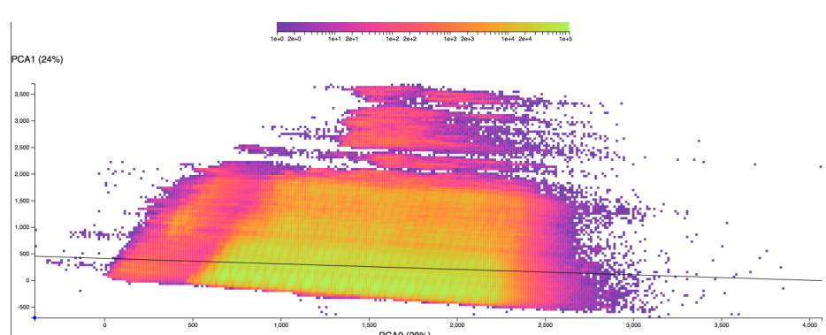
Dimensionality reduction
PCA
Covariance matrix computation is a sketch
Local Affine Multidimensional Scaling

Slide 60
Weak scaling - throughput

Slide 61
Service capacity

Slide 62
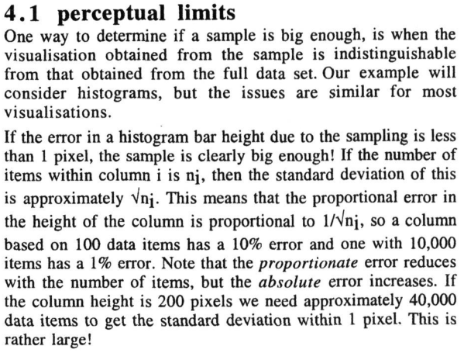

Approximate renderings

